Slide 1
Phylodynamics for recombining pathogens
Inferring phylogenetic networks
Nicola Felix Müller, PhD
e-mail: nicola.felix.mueller@gmail.com

Slide 2
Phylogenetic tree denote approximate the transmission history

Slide 3
Processes, such as co-infection can lead to a person carrying pathogens from more than one source

Slide 4
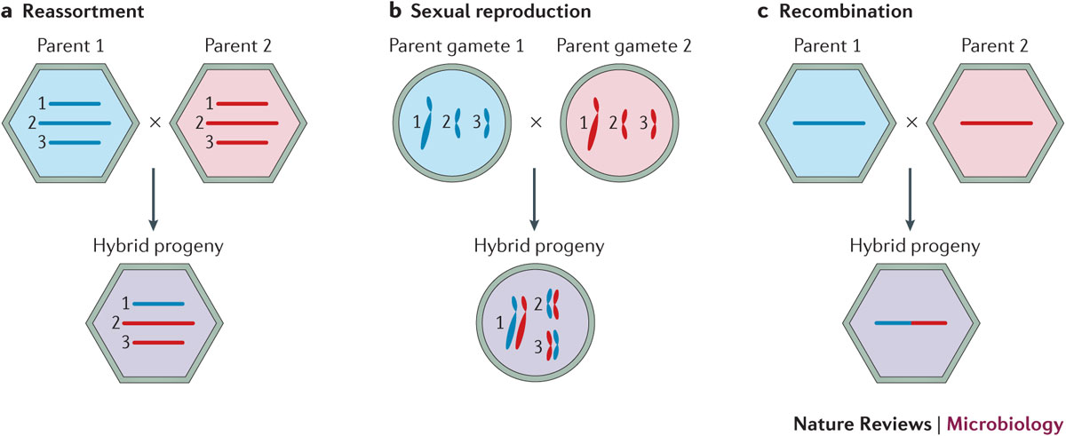
Different processes to “mix” genetic materials from two parent lineages exist

Slide 5
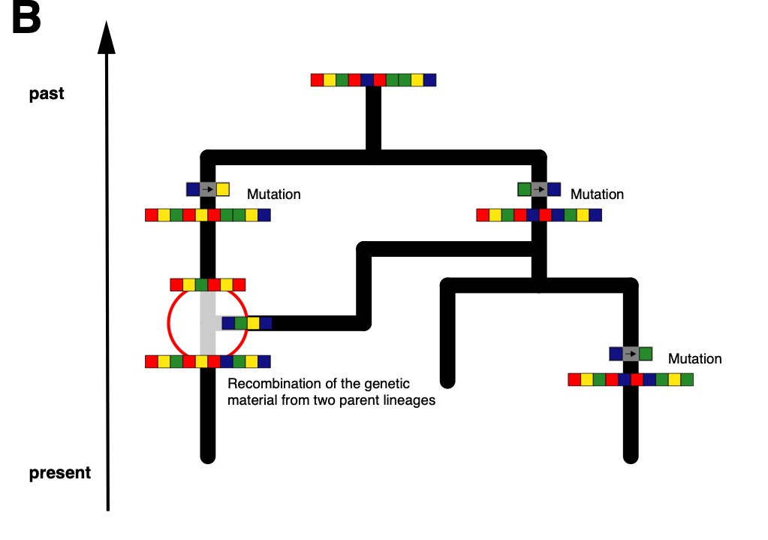
The combined genetic material may represent a network and not a tree

Slide 6
Genetic recombination processes lead to different parts of a genome coding for different histories

Slide 7
Ways to deal with recombination
Only use small parts of the genome that code for the same tree (e.g. only use one segment of influenza).
Consider different parts of a genome to be independent (Bad if they are not).
Just ignore recombination (bad if there is).
Infer networks instead of trees. (Best case, but potentially slow)

Slide 8
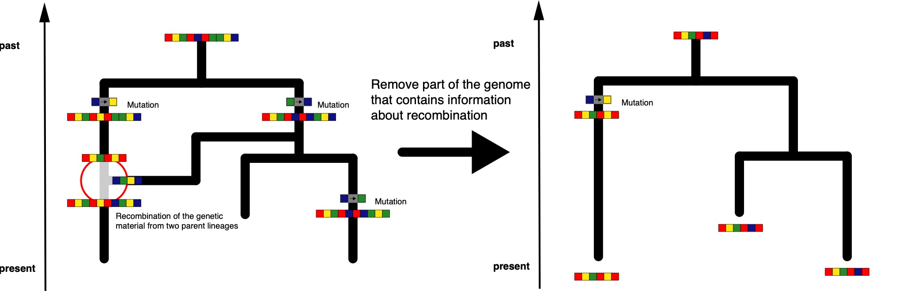
Only use small parts of the genome that code for the same tree.

Slide 9
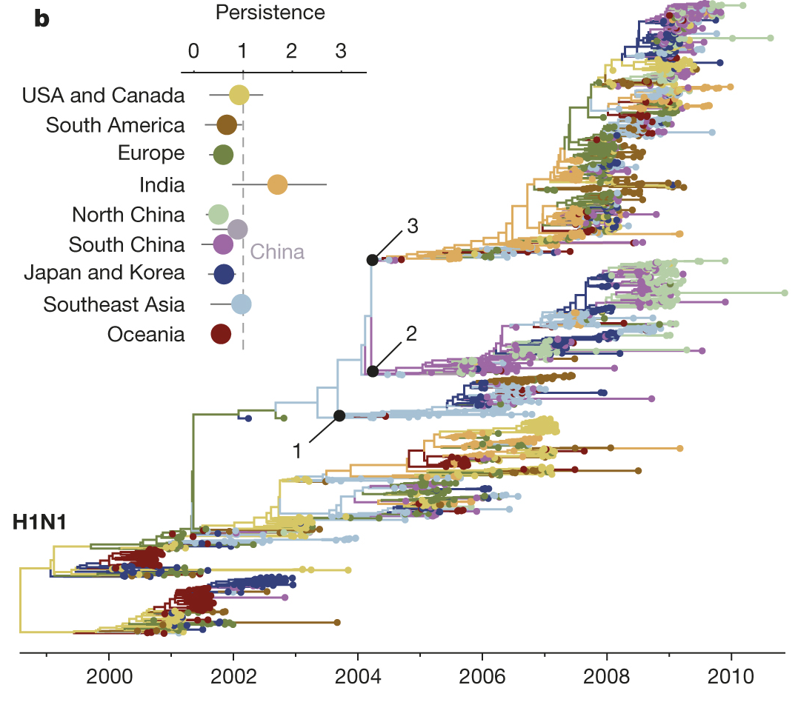
Population dynamics can be inferred from individual influenza segments
Bedford et al., 2015, Nature

Slide 10
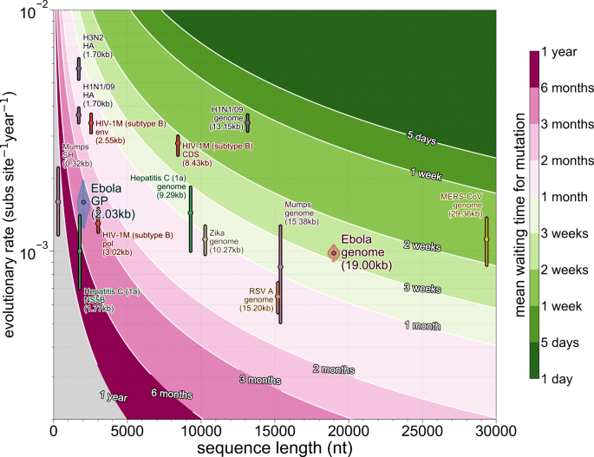
Using only part of pathogen genomes reduces time resolution
Dudas et al., 2019, BMC Eco. Evo.

Slide 11
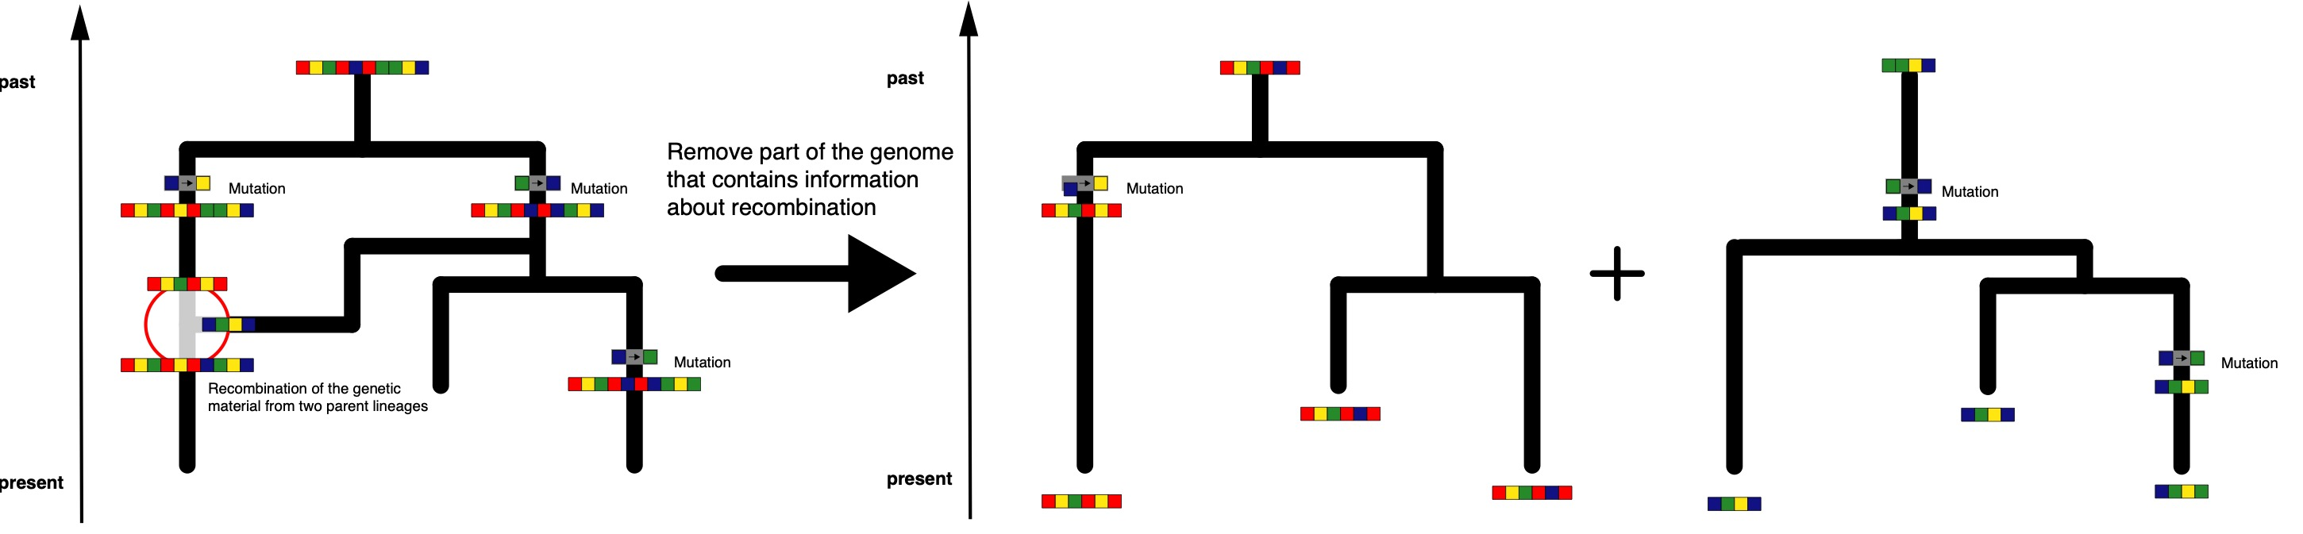
Consider different parts of a genome to be independent. (Sometimes correct)

Slide 12
Species tree inferences typically assume individual parts of the genome to be independent observations of a speciation process

Slide 13
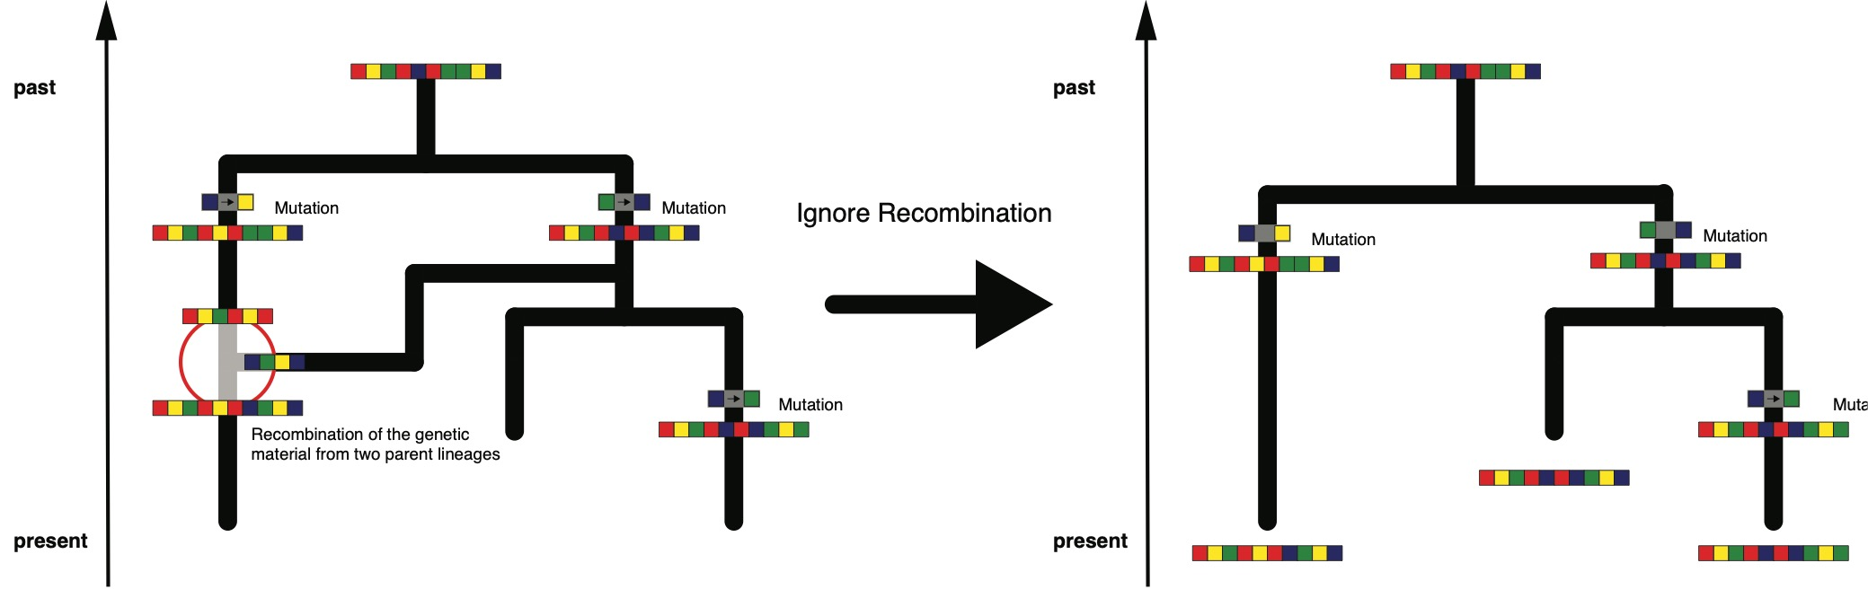
Just ignore recombination. (Always wrong)

Slide 14
QUESTIONS?

Slide 15
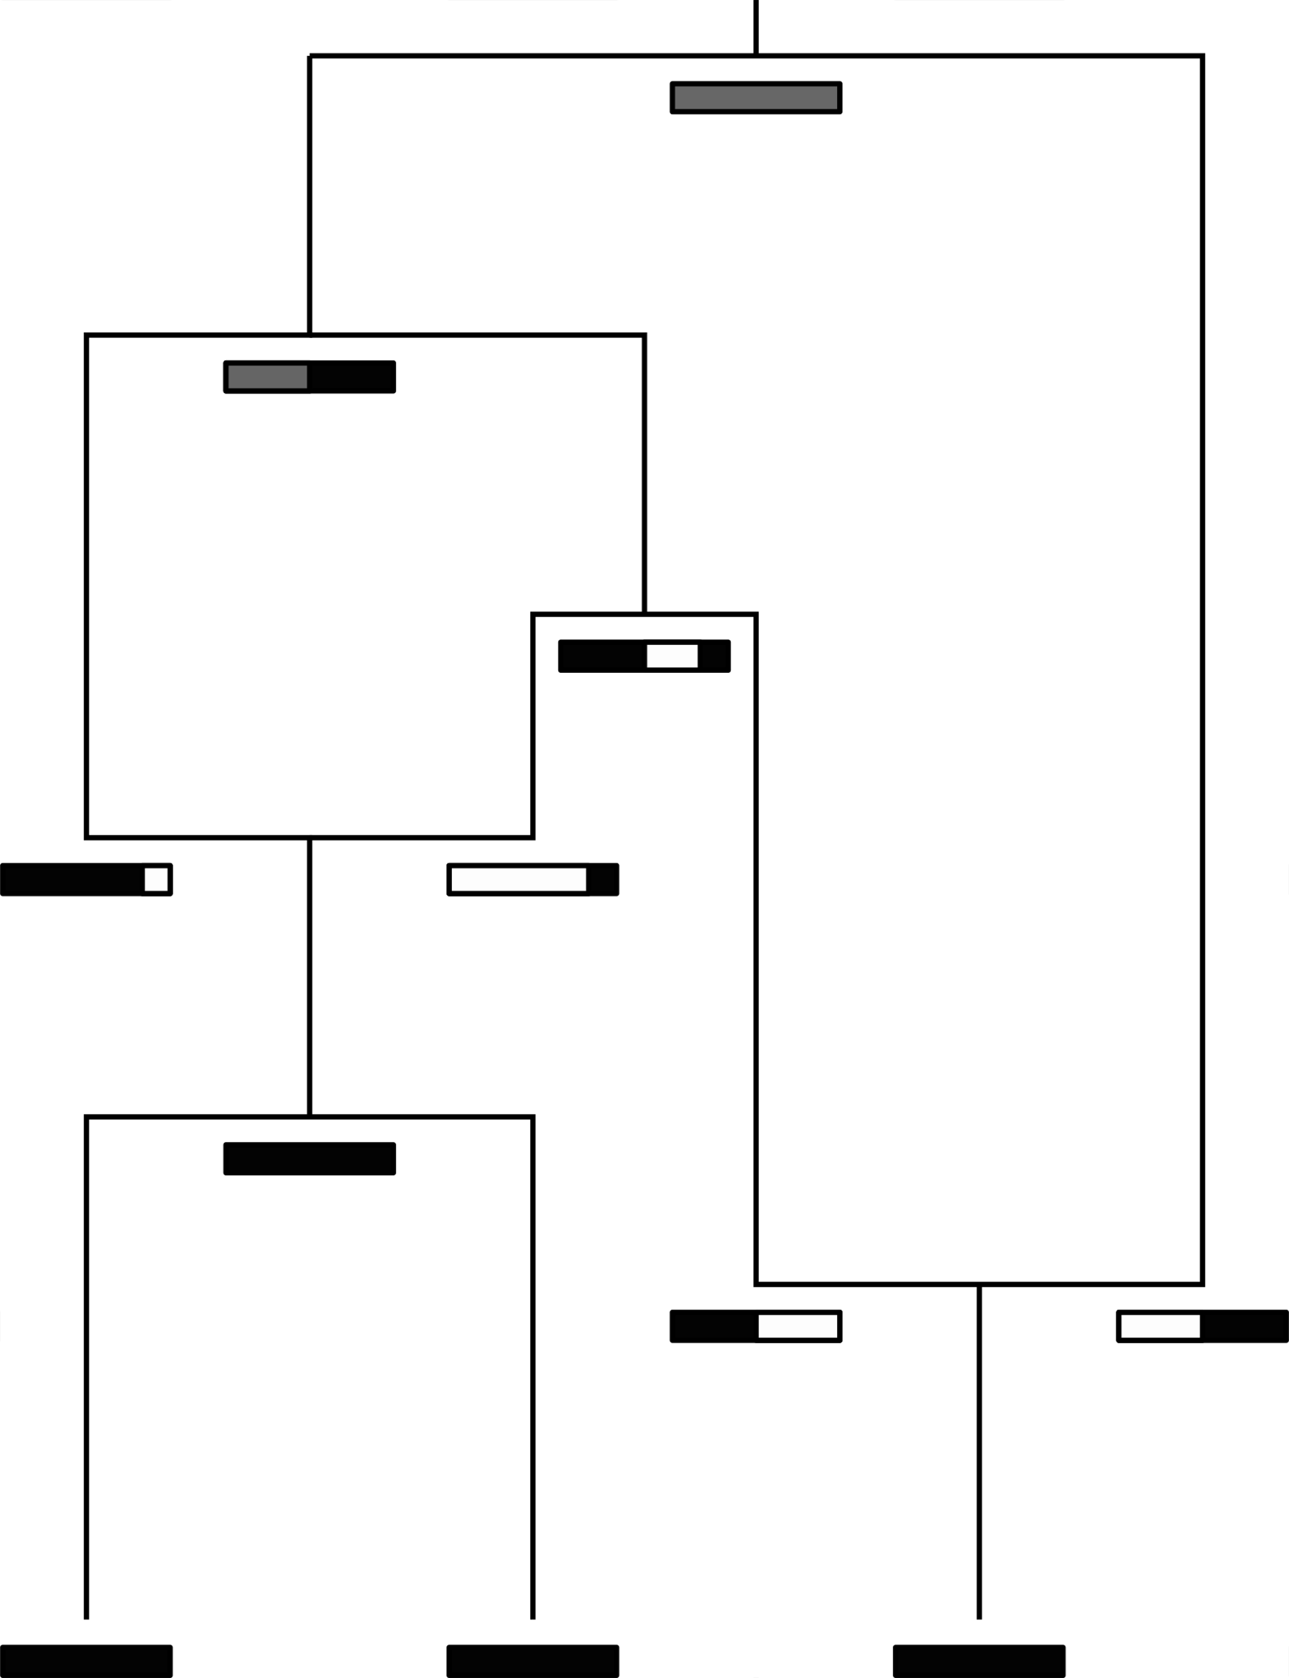
The coalescent with recombination models how lineages coalesce (Wiuf and Hein, 2000)
Coalescent rate is given by 1/Ne
Recombination rate is r
Recombination breakpoints uniformly chosen across alignment
Slide from Tim Vaughan

Slide 16
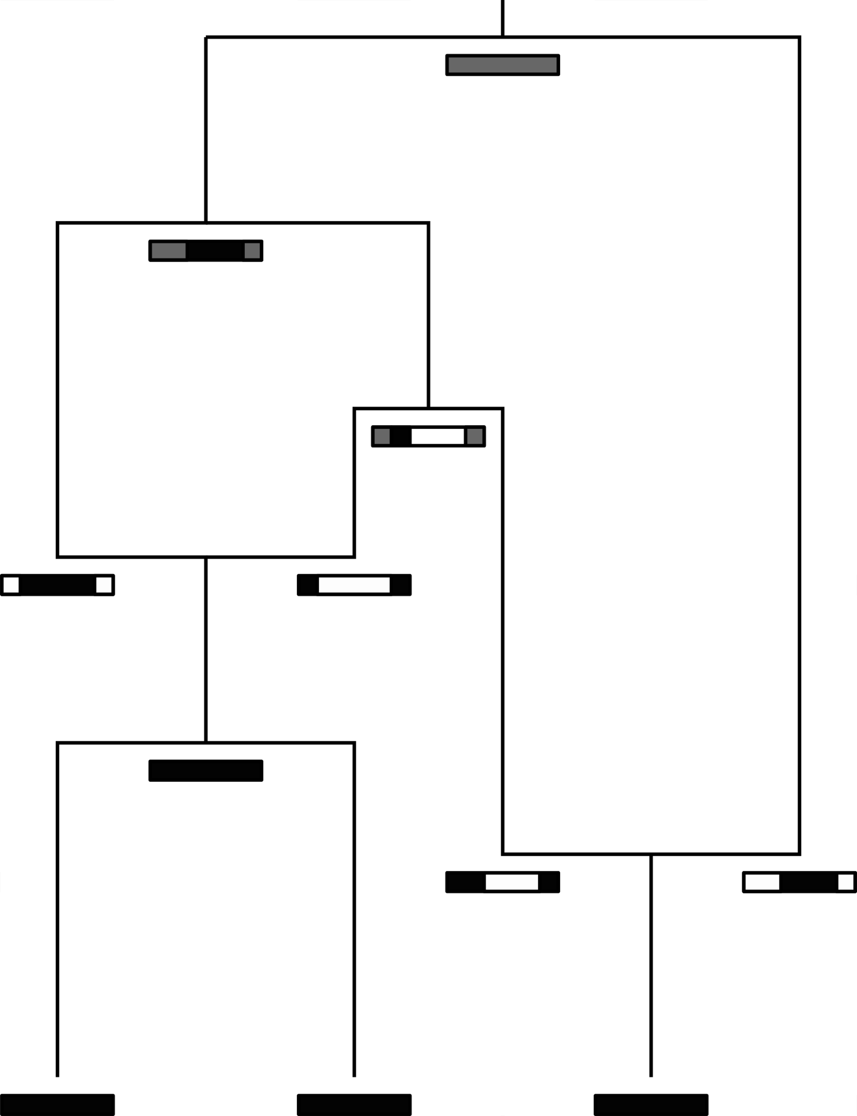
The coalescent with gene conversion models how lineages coalesce (Wiuf and Hein, 2000)
Coalescent rate is given by 1/Ne
Gene conversion rate is r
Gene conversion happens at random site and for elements of random length
Slide from Tim Vaughan

Slide 17
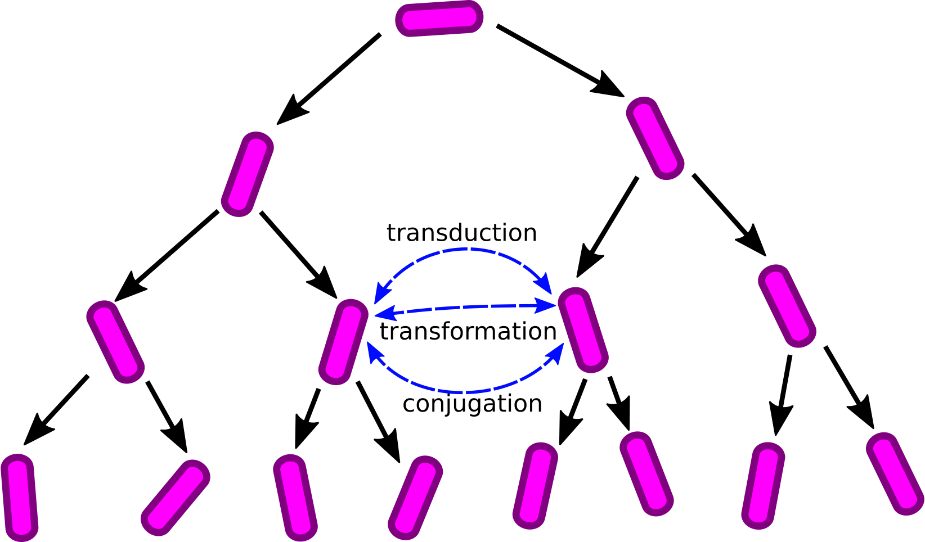
The coalescent with gene conversion can be use to model the exchange of genetic material between bacteria
Slide from Tim Vaughan

Slide 18
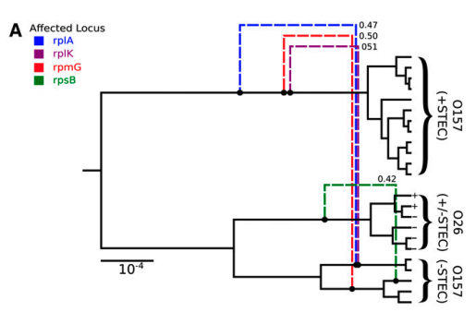
Ancestral recombination graphs for the coalescent with gene conversion can be inferred in BEAST2 using Bacter
Allows to estimate tree based networks that have a base tree and edges that detach and re-attach directly to that base tree
Requires the assumption that only a small part of the genome is subject to recombination

Slide 19
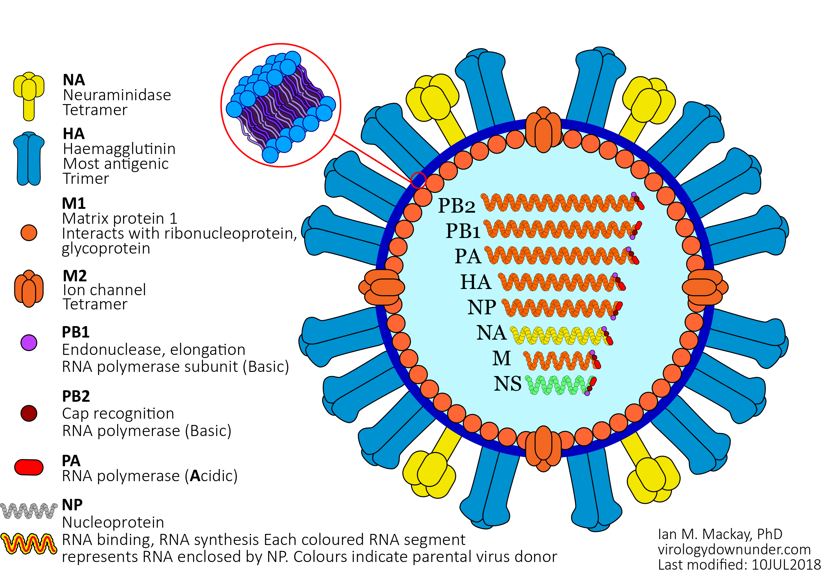
The genome of Influenza in organized in several separated segments
Mackay, I. M.. Influenza virus. (2018). doi:10.6084/m9.figshare.6817112.v1
Notes:
Genome of influenza is build up by several spatially separated segments.
Each segment code for one or more Proteins.
Proteins have different functions, HA NA antigens, cell binding.

Slide 20
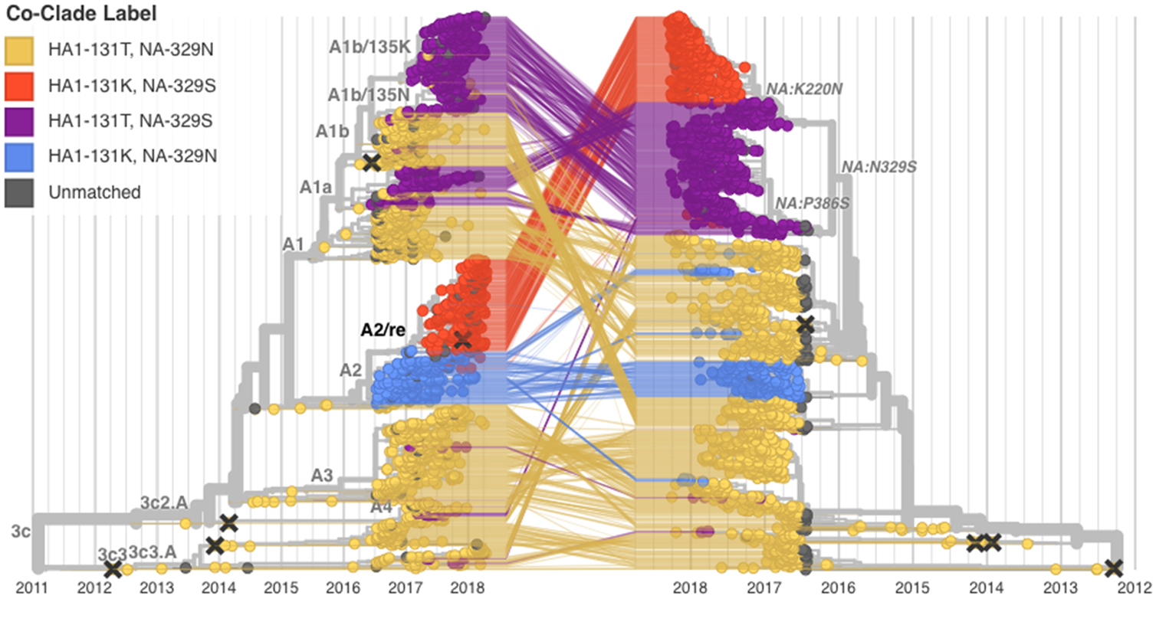
Segmented viruses can reassort, leading different segments to code for different trees
Potter et al. (2019), Virus Evol.

Slide 21
In order to properly account for reassortment in Bayesian phylogenetics, we need:
To be able to calculate a posterior probability
To explore this posterior probability space (here using MCMC)

Slide 22
For phylogenetic trees, we can express the posterior probability as:
DuPlessis, L. et al. (2015),
Trends in Microbiology

Slide 23
To switch to networks, we conceptually just replace the tree terms with networks

Slide 24
To switch to networks, we conceptually just replace the tree terms with networks
The network likelihood can be expressed as a product of tree likelihoods on the different nucleotide positions
The network prior requires a network generating model, such as a coalescent process

Slide 25
The coalescent with reassortment models a joint coalescent and reassortment process
Non tree based network where node heights are in real time.
Every network edge carries genetic material with sampled descendants.
Every edge in the network is equivalent.
Notes:
Different modes of genetic recombination can be beneficial for viruses, for example, by:
Purging deleterious mutations.
Combining beneficial mutations.
The observed rate of recombination events depends on:
Rate of co-infection.
Rate of recombination within a host.
Rate of selection.

Slide 26
CoalRe allows inferring reassortment networks, reassortment rates etc. jointly
Müller et al. (2020), PNAS

Slide 27
Correctly modelling the reassortment process impact precision and reduces bias
Müller et al. (2020), PNAS

Slide 28
Explicitly modeling when and where reassortment events occurred allows us to investigate whether there are patterns
Müller et al. (2020), PNAS
Notes:
Since we infer actual networks, we can also check to see if there are particular parts of these networks where reassortment rates are elevated.
What we find is that for most human influenza viruses, there is evidence that reassortment events occur more often on lineages that are more likely to persist for a long time, suggesting a fitness benefit to reassortment

Slide 29
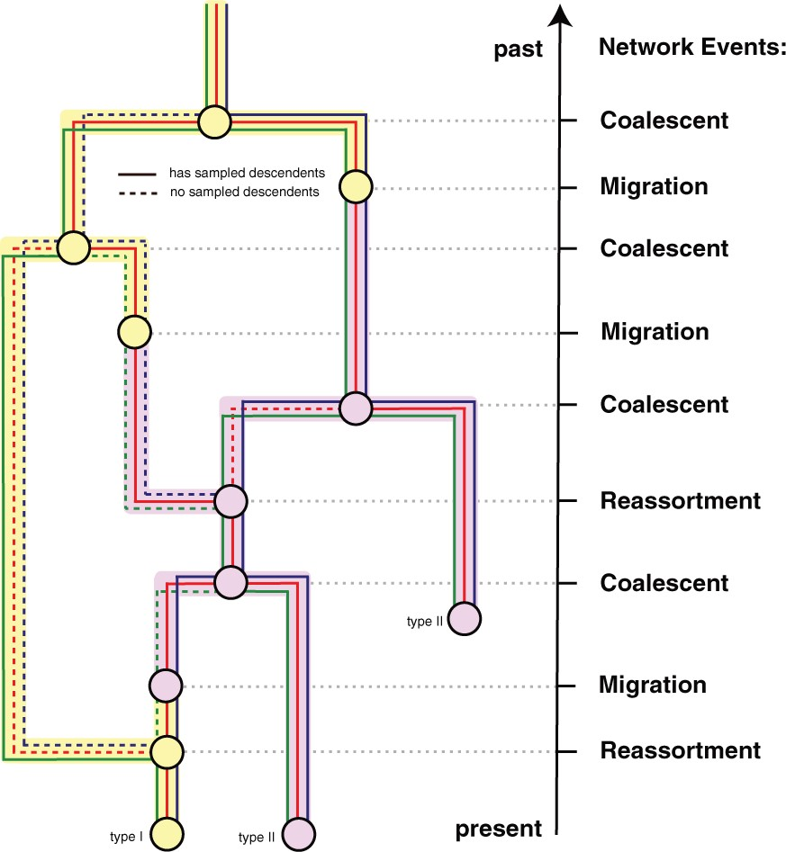
Reassortment and population structure can be reconstructed jointly
Stolz et al. (2021), Mol. Biol. Evol.

Slide 30
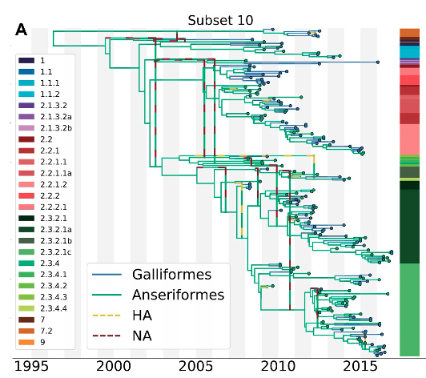
The structured coalescent with reassortment can be used to reconstruct where and when reassortment occurred.
Stolz et al. (2021), Mol. Biol. Evol.

Slide 31
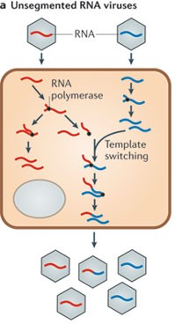
Some RNA viruses, including coronaviruses, can recombine in a process called template switching
Simon-Loriere et al. (2011), Nat. Rev. Mic
Notes:
Some RNA viruses, including coronaviruses, can recombine in a process called template switching.
Viruses produced in this process can carry information about different evolutionary histories and therefore phylogenetic trees on different parts of the genome.
As soon as there is recombination in my sequence alignment, this also means that I can no longer use the standard toolbox of phylogenetic and phylodynamic methods to study, for example, SARS-CoV-2.
This means that we again need some model to account for this process.

Slide 32
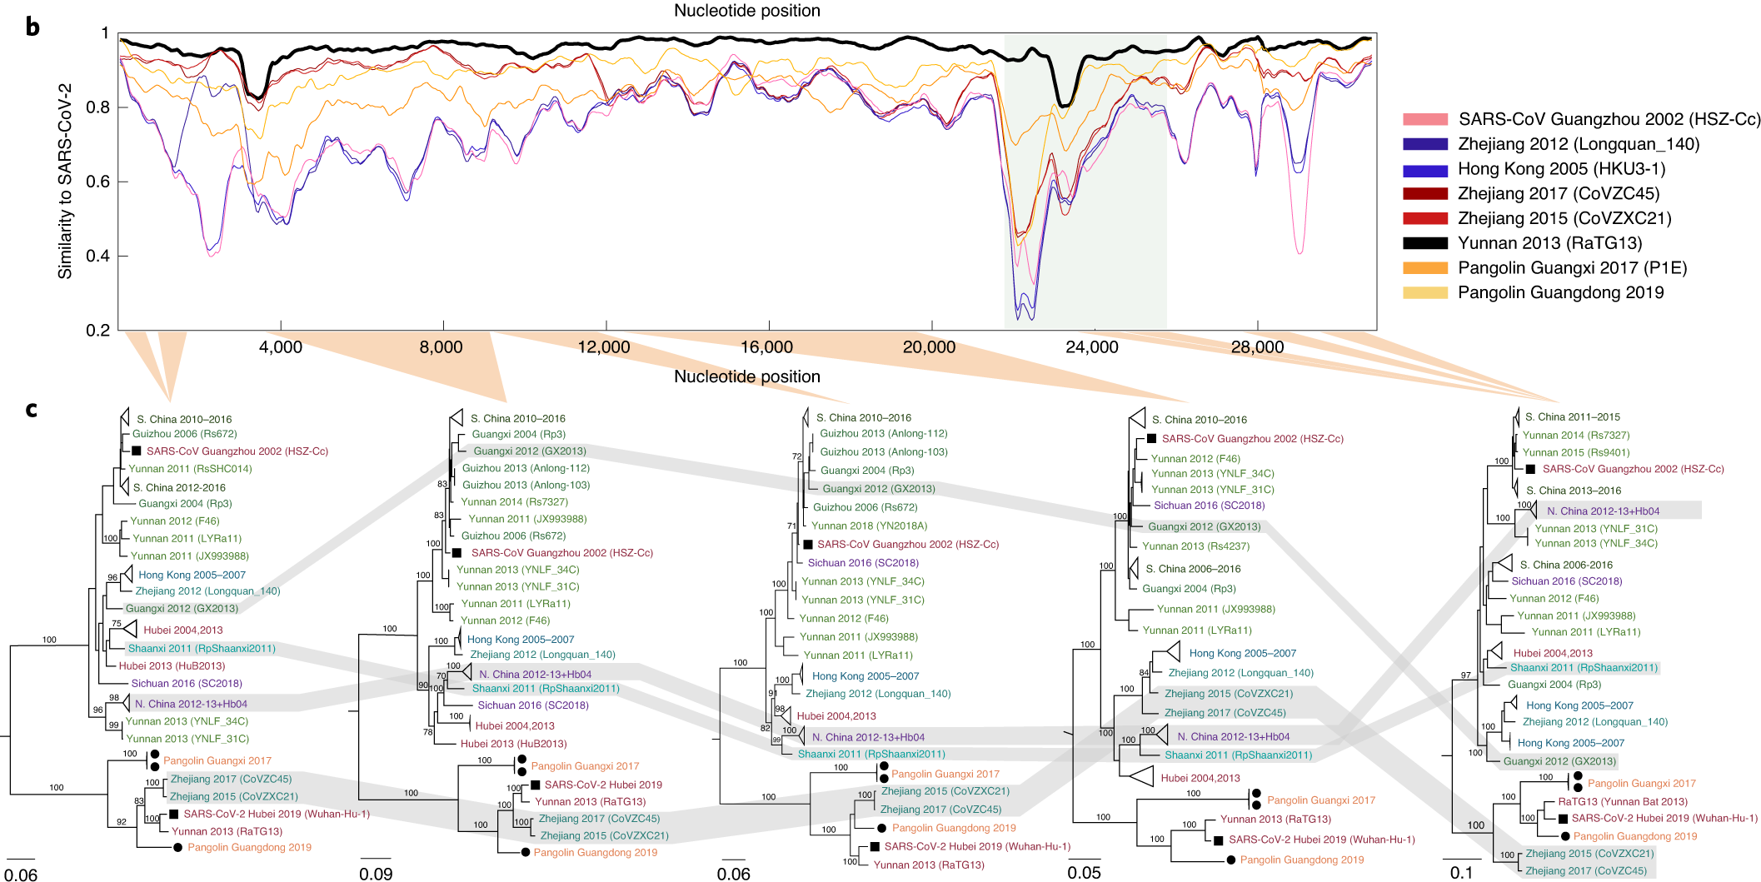
Different parts of the genome of SARS-like viruses code for different ”trees”
Boni et al. (2020), Nat. Mic.
Notes:
Some RNA viruses, including coronaviruses, can recombine in a process called template switching.
Viruses produced in this process can carry information about different evolutionary histories and therefore phylogenetic trees on different parts of the genome.
As soon as there is recombination in my sequence alignment, this also means that I can no longer use the standard toolbox of phylogenetic and phylodynamic methods to study, for example, SARS-CoV-2.
This means that we again need some model to account for this process.

Slide 33
To switch to networks, we conceptually just replace the tree terms with networks

Slide 34
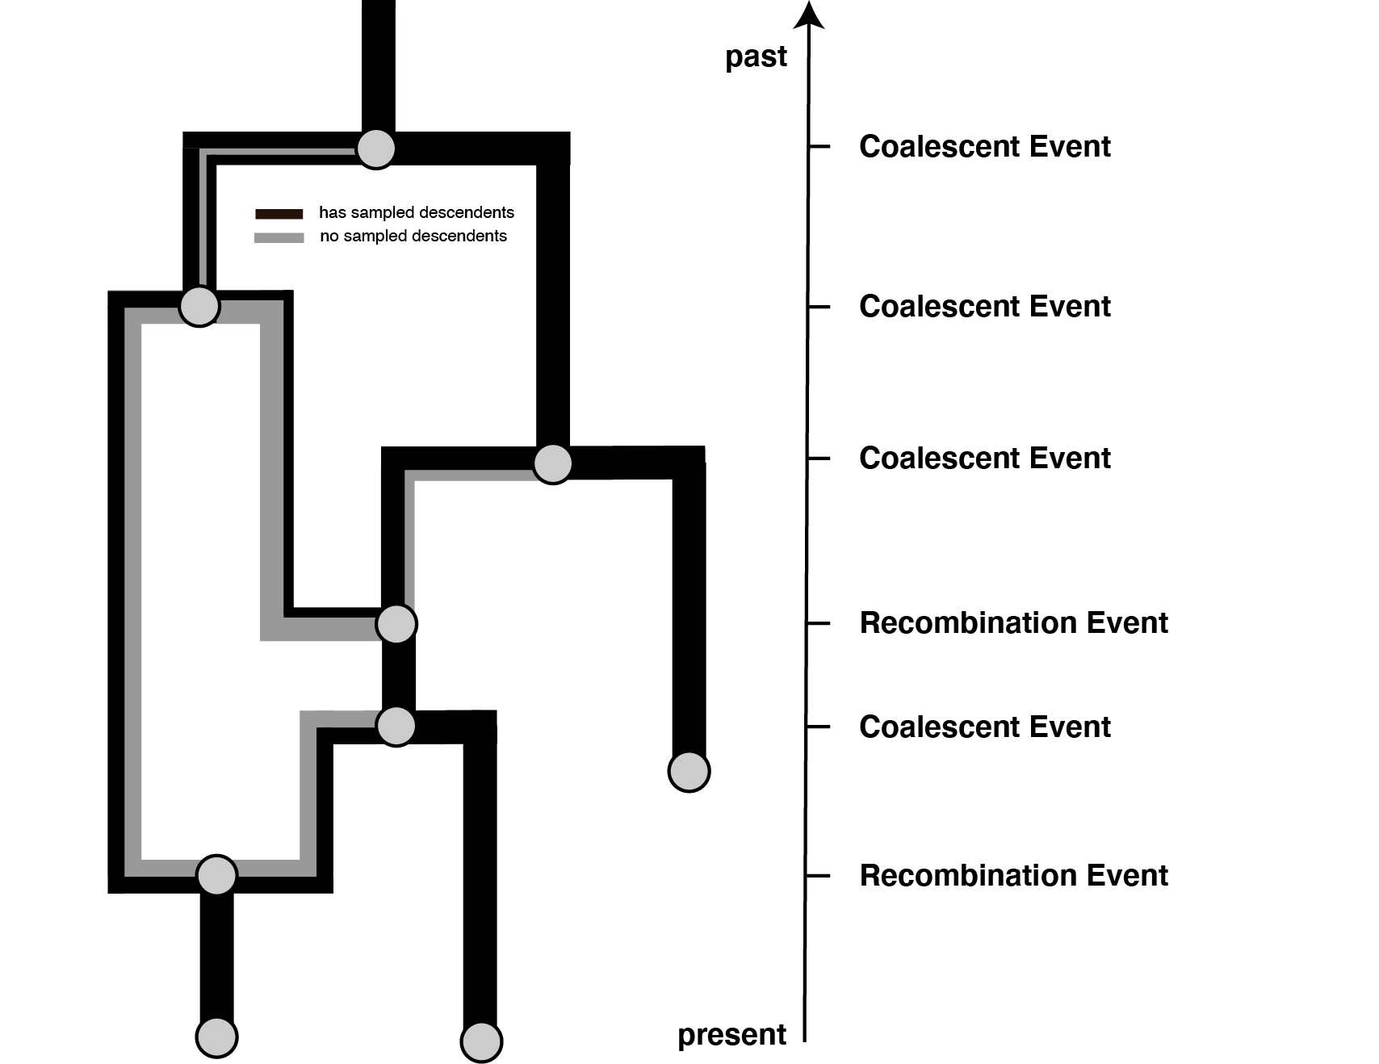
The complex recombination process can be simplified and modeled as a joint coalescence and recombination process.
Müller et al. (2022), Nat. Comm.
Notes:
We again need three things.
We need to allow for sampling events, that is pathogens being isolated and sequenced.
We need to allow for coalescent events that denote when two pathogens last shared a common ancestor
And we need to allow for recombination events where one one side of a recombination breakpoint, the genome codes for one evolutionary history and on the other side for another history.
Using this simple coalescent with recombination model, alongside a quite complex Bayesian inference framework, allows us to infer recombination networks of coronaviruses.

Slide 35
Recombination events can be inferred well, but getting actual posterior support values is hard
Müller et al. (2022), Nat. Comm.

Slide 36
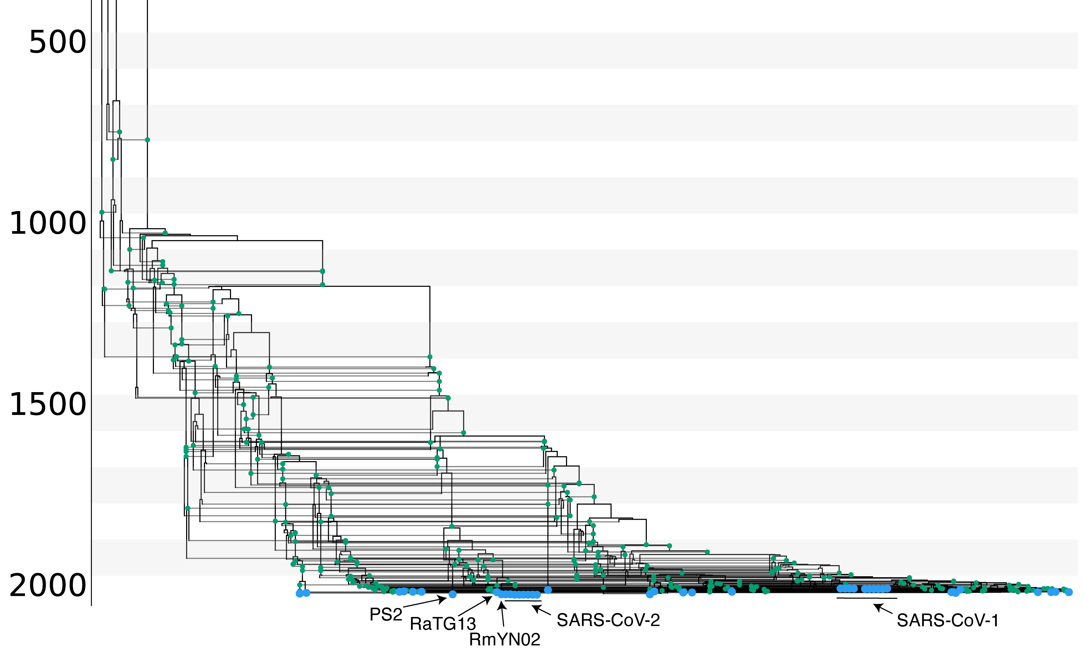
Recombination events shaped the evolutionary history of SARS-like viruses.
Müller et al. (2022), Nat. Comm.
Notes:
We can then use the coalescent with recombination to infer the evolutionary history of SARS-like viruses.
Each vertical line and green dot denotes a different recombination event.
What we can see here is that recombination plays an crucial role in shaping the evolution of SARS-like viruses.
In what way exactly is unclear, but there are definitely a lot of those recombination events.
We can also use this approach to study which are the closest relatives or SARS-CoV-2 that were sequenced.
While RaTG13 in pink is the closest relative to SARS-CoV-2 in terms of sequence identity, RmYN02 in orange shares the most recent common ancestor with SARS-CoV-2.
While recombination shapes the evolution of these viruses in the animal reservoir, we can next check whether this is the case in other host as well.

Slide 37
Evidence for a few recombination events in the recent history of SARS-CoV-2 before entering the human population
Müller et al. (2022), Nat. Comm.

Slide 38
Recombination events shaped the evolutionary history of SARS-like viruses.
Müller et al. (2022), Nat. Comm.

Slide 39
The analyzed SARS-like dataset contains about 300 recombination events, meaning the average number of consecutive basepairs that code for the same tree is 100
Müller et al. (2022), Nat. Comm.

Slide 40
RmYN02 is the closest common ancestor to SARS-CoV-2 on most parts of the genome.
Müller et al. (2022), Nat. Comm.

Slide 41
Notes:
To do so, we reconstructed the recombination networks of 4 other coronaviruses.
Mers, where the main host are camel with occasional spill over into humans and 3 seasonal human covoronaviruses, 229e, oc42 and nl63.
We can see that recombination shapes the evolutionary history of these viruses.
In fact, if we look at these rates of recombination, we find that they are quite comparable to reassortment rates in influenza viruses.

Slide 42
Recombination rates vary with rates of adaptation across the genomes of seasonal coronaviruses
Müller et al. (2022), Nat. Comm.

Slide 43
QUESTIONS?

Slide 44
Some reading material
Coalescent with recombination: https://doi.org/10.1016/0040-5809(83)90013-8
Coalescent with gene conversion: https://www.genetics.org/content/155/1/451.short
ARG’s for bacteria: https://www.genetics.org/content/205/2/857
Coalescent with reassortment: https://www.pnas.org/content/early/2020/07/02/1918304117

